Slide 1

Rice Services

Slide 2

Services
Finding Services
  Service locators
KNS Services
  BusinessObjectService
  LookupService
  DataDictionaryService
  BusinessObjectDictionaryService
  BusinessObjectMetaDataService
  MaintenanceDocumentDictionaryService
  TransactionalDocumentDictionaryService
  ParameterService
  DateTimeService
Workflow Related Services
  KualiWorkflowInfo
  DocumentService

Slide 3

Service Locators
Each module has a service locator.
Most services are available with simple getters.
There is also a method to allow you to pull any service by name:
  public static Object getService(String serviceName)
  This method will check the local spring context first, and then check the KSB.

Slide 4
KNS Services
BusinessObjectService
LookupService
DataDictionaryService
  BusinessObjectDictionaryService
  MaintenanceDocumentDictionaryService
  TransactionalDocumentDictionaryService
BusinessObjectMetaDataService
ParameterService
DateTimeService

Slide 5
Business Object Service
Persistence and retrieval of business objects
Also has rudimentary lookup capabilities
Basic methods:
  public void save(PersistableBusinessObject bo);
  public PersistableBusinessObject findByPrimaryKey(Class clazz, Map primaryKeys);
  public Collection findMatching(Class clazz, Map fieldValues);
  public void delete(PersistableBusinessObject bo);

Slide 6
Lookup Service
Not as important, but fills some gaps in the BO Service functionality
Should be used instead of custom DAOs when possible to limit dependency on OJB and JPA-specific classes.
Main Methods:
  public Collection findCollectionBySearch(Class example, Map formProps);
  public Collection findCollectionBySearchUnbounded(Class example, Map formProps);
  public Object findObjectBySearch(Class example, Map formProps);
Supports special handling of numbers, dates, and booleans.
Properties can have additional codes embedded.

Slide 7

Lookup Special Codes
Worth a mention since they are not documented (AFAIK)
Characters | Description
* or % | wildcard
? | single-character wildcard
> or >= | greater than / greater than or equal
< or <= | less than / less than or equal
.. | range search - e.g., ABCDEFG..HIJKLMN
&& | AND
| | OR
! | NOT

Slide 8
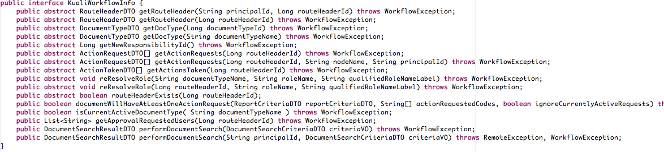
Workflow Services
KualiWorkflowInfo
  Wrapper around the main workflow contact point (WorkflowUtility/WorkflowUtilityWebServiceImpl)
  All methods return DTOs rather than internal KEW objects.

Slide 9
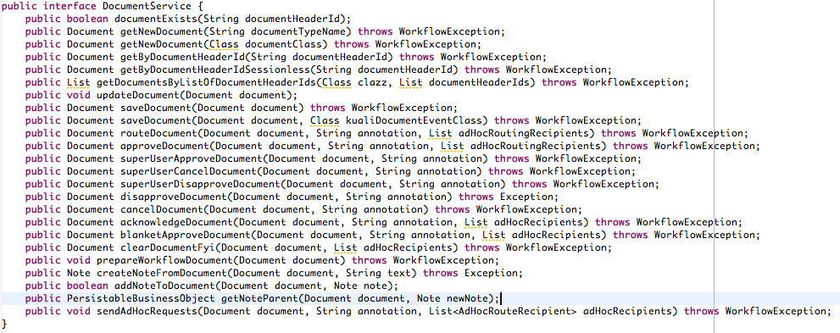
Workflow Services
DocumentService
  Wrapper around the KualiWorkflowInfo service for document-centric actions.
  This should be used whenever possible

Slide 10
Data Dictionary Service
Avoid using if possible
Use the more specific services:
  BusinessObjectDictionaryService
  MaintenanceDocumentDictionaryService
  TransactionalDocumentDictionaryService
Simplify some of the calls and protect from NPEs
But, not all needed information has been added to the additional service APIs

Slide 11
BO Metadata Service
Abstraction layer that merges the ORM tool and DD metadata
DD metadata takes precedence
This should be used in place of the PersistenceStructureService whenever possible.
  It is primarily used for relationship and primary key checks.
PersistenceStructureService is also an abstraction layer over the ORM tool, and can provide type information not passed to the

Slide 12

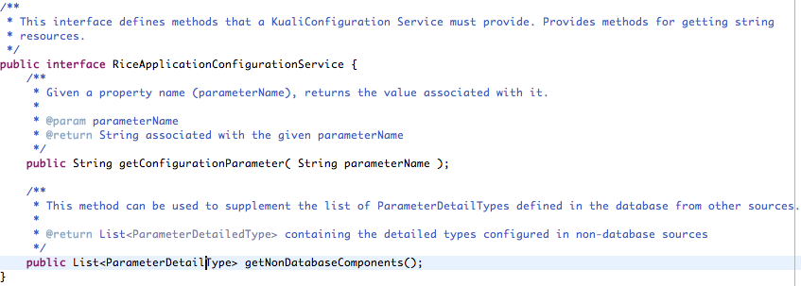
RiceApplicationConfigurationService
Relatively new service
Used to give a central Rice server information about client applications.

Slide 13

Parameter Service
User changeable system properties
Business rules can use these
  Special API methods and parsing conventions exist
Also provides access to configuration properties
ParameterEvaluator
  Can auto-add errors to the ErrorMap object that documents use.
Constraining Value vs. Constrained Value

